Slide 1

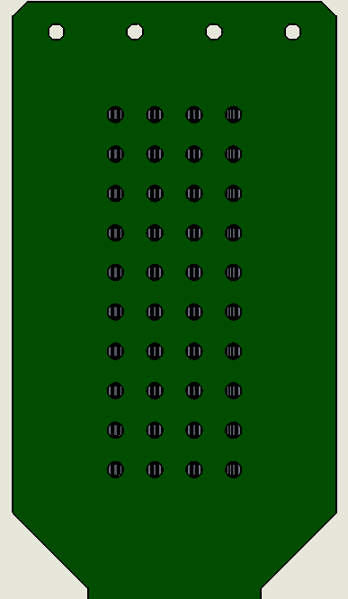
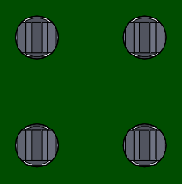
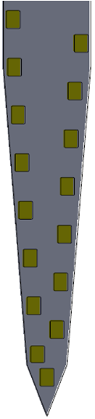
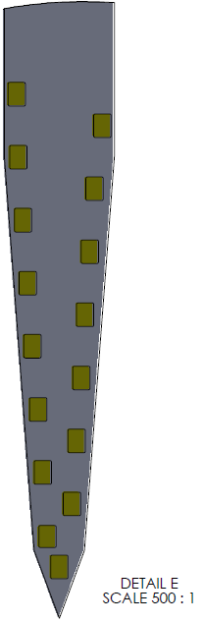
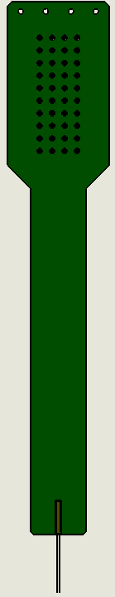
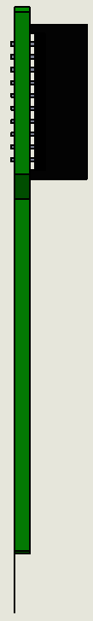
Mapping for Acute 32-Channel Probe
250μm spacing
ASSY-37 – E-1 & E-2
Red Wire = REF
White Wire = GND
Electrodes are located on the side of the probe as indicated by the arrow below - use Shank A orientation as a reference to construct the channel-map in to your headstage pre-amplifier.
Red Wire and White Wire correspond to indicated REF and GND pins on the probe connector - verify how these connect to your headstage pre-amplifier (often 1 wire is sufficient).
REF # 1
REF # 2
GND # 1
GND # 2
11
9
7
5
3
2
6
8
10
12
32
30
31
28
29
27
25
22
23
21
REF # 1
REF # 2
1
4
13
14
15
16
26
24
20
19
18
17
GND # 1
GND # 2
Shank A
Shank B
16
17
15
18
12
21
10
23
8
22
14
19
6
25
13
20
2
27
4
24
3
29
1
26
5
28
7
31
9
30
Shank A
11
32
Last updated: 11.01.17

Slide 2
ASSY-37– E-1 – SHARP
PART # 1 – PN 3263
Site | MOhm | Phase(°)
1 | 0.043 | -37.1
2 | 0.043 | -36.5
3 | 0.044 | -35.5
4 | 0.043 | -36.2
5 | 0.043 | -35.4
6 | 0.044 | -34.6
7 | 0.043 | -36.8
8 | 0.043 | -35.3
9 | 0.043 | -36
10 | 0.045 | -36.9
11 | 0.042 | -37.1
12 | 0.044 | -34.1
13 | 0.044 | -36.9
14 | 0.045 | -35.3
15 | 0.044 | -35
16 | 0.044 | -35.6
17 | 0.044 | -33.7
18 | 0.044 | -33.6
19 | 0.043 | -33.8
20 | 0.044 | -35.8
21 | 0.044 | -34.5
22 | 0.043 | -35.6
23 | 0.043 | -35.2
24 | 0.043 | -34.3
25 | 0.044 | -34.4
26 | 0.043 | -35.4
27 | 0.044 | -35.6
28 | 0.044 | -35.2
29 | 0.043 | -34.7
30 | 0.044 | -34.4
31 | 0.043 | -35.3
32 | 0.041 | -35.1
PART # 1 – PN 3264
Site | MOhm | Phase(°)
1 | 0.044 | -35.5
2 | 0.044 | -35
3 | 0.044 | -36.7
4 | 0.044 | -35
5 | 0.043 | -35.5
6 | 0.043 | -35.5
7 | 0.043 | -35.3
8 | 0.044 | -35.1
9 | 0.043 | -34.7
10 | 0.045 | -35.5
11 | 0.043 | -35.8
12 | 0.044 | -36
13 | 0.044 | -35.7
14 | 0.044 | -34.6
15 | 0.045 | -35.1
16 | 0.045 | -34.4
17 | 0.045 | -35.9
18 | 0.046 | -35.6
19 | 0.045 | -34.4
20 | 0.044 | -34.1
21 | 0.044 | -34.5
22 | 0.045 | -35.7
23 | 0.044 | -35.3
24 | 0.044 | -34
25 | 0.044 | -34.9
26 | 0.045 | -34.7
27 | 0.045 | -35.6
28 | 0.044 | -34.8
29 | 0.043 | -35.2
30 | 0.044 | -34.3
31 | 0.044 | -34
32 | 0.043 | -37.3

Slide 3
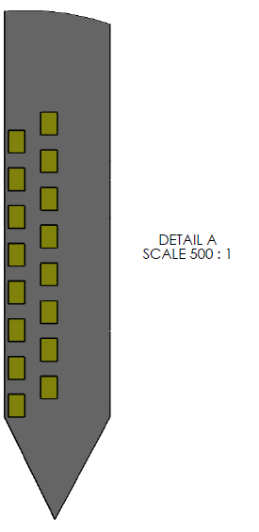
Mapping for Acute 32-Channel Probe
250μm spacing
ASSY-37 – P-1 & P-2
Red Wire = REF
White Wire = GND
Electrodes are located on the side of the probe as indicated by the arrow below - use Shank A orientation as a reference to construct the channel-map in to your headstage pre-amplifier.
Red Wire and White Wire correspond to indicated REF and GND pins on the probe connector - verify how these connect to your headstage pre-amplifier (often 1 wire is sufficient).
REF # 1
REF # 2
GND # 1
GND # 2
11
9
7
5
3
2
6
8
10
12
32
30
31
28
29
27
25
22
23
21
REF # 1
REF # 2
1
4
13
14
15
16
26
24
20
19
18
17
GND # 1
GND # 2
Shank A
Shank B
3
5
9
11
7
1
13
10
29
28
30
32
31
26
20
23
16
12
8
6
2
4
14
15
17
21
22
25
27
24
19
18
Shank A
Last updated: 11.01.17

Slide 4
ASSY-37– P-1 – SHARP
PART # 1 – PN 3265
Site | MOhm | Phase(°)
1 | 0.04 | -38.4
2 | 0.038 | -40.3
3 | 0.04 | -39.1
4 | 0.039 | -39.8
5 | 0.039 | -37.9
6 | 0.04 | -40
7 | 0.043 | -36.4
8 | 0.039 | -40.3
9 | 0.04 | -38.9
10 | 0.04 | -37.3
11 | 0.04 | -38.2
12 | 0.039 | -40.1
13 | 0.04 | -38.5
14 | 0.04 | -38
15 | 0.036 | -37.7
16 | 0.038 | -38.6
17 | 0.039 | -40.3
18 | 0.037 | -39.5
19 | 0.039 | -41.1
20 | 0.039 | -38.2
21 | 0.039 | -40.1
22 | 0.038 | -40.5
23 | 0.04 | -38.6
24 | 0.038 | -42
25 | 0.039 | -39.6
26 | 0.04 | -39
27 | 0.039 | -40.9
28 | 0.04 | -38.8
29 | 0.04 | -36.2
30 | 0.039 | -38.7
31 | 0.039 | -40.4
32 | 0.039 | -40.6

